Slide 1
Indie EdTech and the Digital Humanities
Adam Croom

Slide 2
Hi, I’m a practitioner.

Slide 3
Technologies-in-practice through Philosophies-in-practice

Slide 4
Philosophies of Education - Zinn (1990)
Philosophy | Purpose
Liberal | To develop intellectual powers of the mind; to make a person literate in the broadest sense--intellectually, morally, and spiritually.
Behaviorist | To bring about behavior that will ensure survival of human species, societies, and individuals; to promote behavioral change.
Progressive | To transmit culture and societal structure to promote social change; to give learner practical knowledge and problem-solving skills, to reform society
Humanist | To develop people open to change and continued learning; to enhance personal growth and development; to facilitate self-actualization, to reform society.
Radical | To bring about fundamental, social, political, economic changes in society through education; to change culture and its structure.
Notes:
http://cdl.bellevue.edu/academic/Philosophies/Philosophies.html

Slide 5
Determinist Positions on the Philosophy of Technology
Uses determinism – all technologies are neutral tools or devices that simply extend human capacities
Social determinism – social structures influence who is involved/excluded in technological advancement
Technological determinism – all technologies are designed to sustain advantaged populations and hegemonic interests

Slide 6
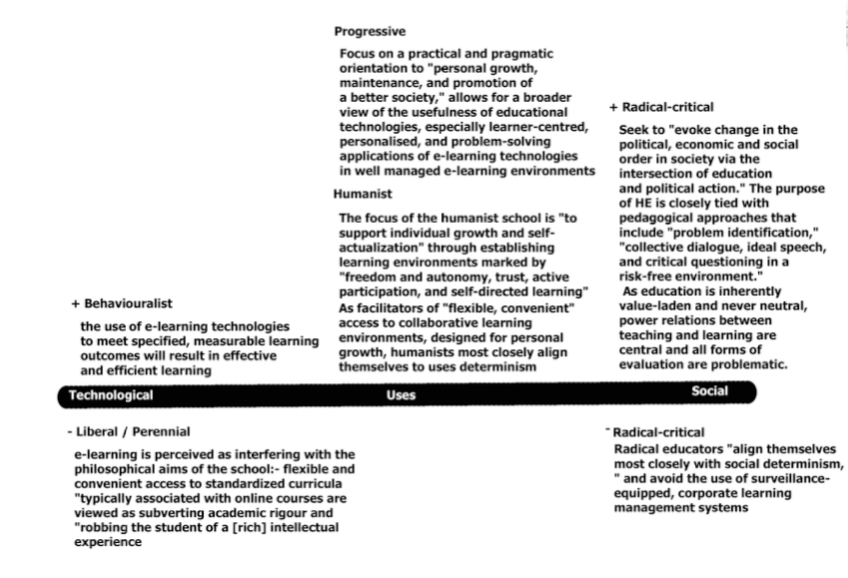
Kanuka (2008)

Slide 7
Kanuka (2008)
“Technologies can, under certain circumstances… can provide flexibility, convenience, and meet individual student needs... Specifically, uses of technology can play a critical role in providing flexible and open access to the growing needs of individual students.”
Kanuka, Heather. "Understanding E-Learning Technologies-IN-Practice." The theory and practice of online learning (2008): 91.

Slide 8
Kanuka (2008)
“For humanists, learning is view as highly personal endeavor, and, as such, self-concept, self-perception, intrinsic motivation, self-evaluation, and discovery are important to learning and thinking skills.”
Kanuka, Heather. "Understanding E-Learning Technologies-IN-Practice." The theory and practice of online learning (2008): 91.

Slide 9
Kanuka (2008)
“Without knowing our philosophical orientation, other strategies are used (in choosing technologies). Often swept up by unbridled – but uninformed –enthusiasm by technological advocates, many decisions by educators are based on following the latest trend.”

Slide 10

A Room of One’s Own
“A woman must have money and a room of her own if she is to write fiction.”

Slide 11
A Domain of One’s Own
“A [student] must have a [domain] of her own if she is to write.”

Slide 12




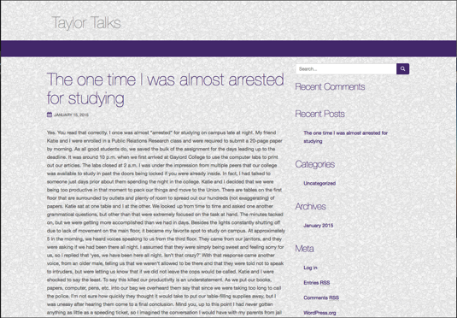

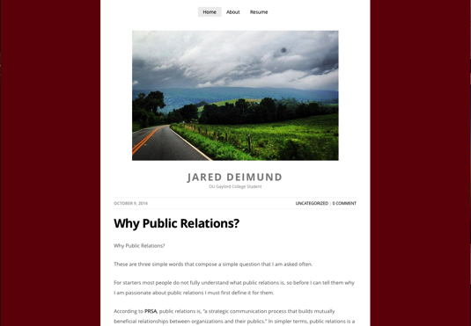
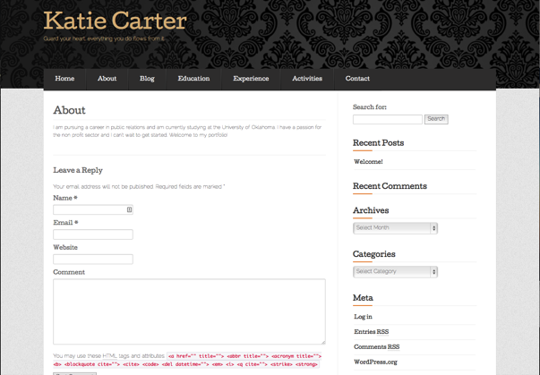

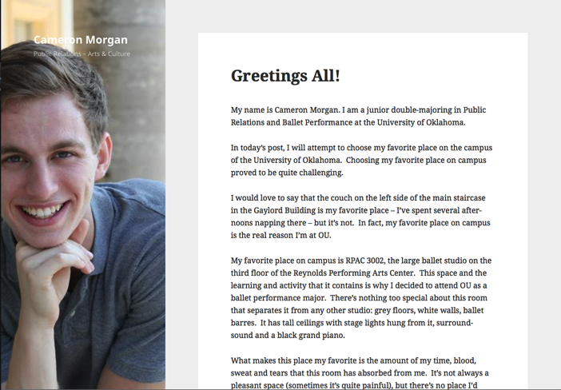

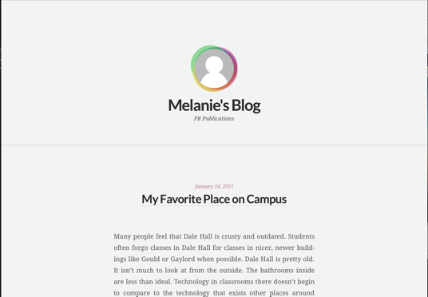
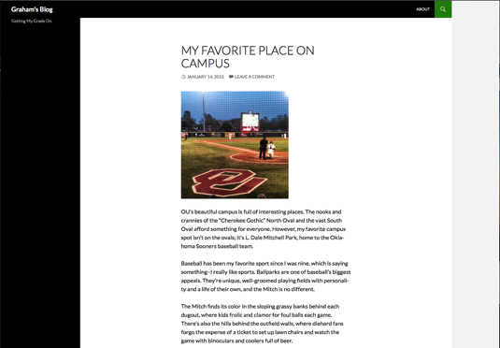

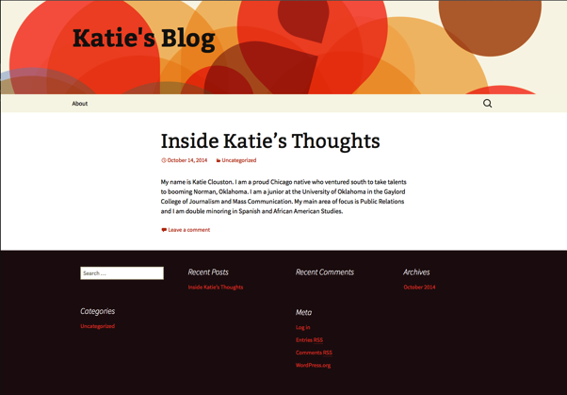
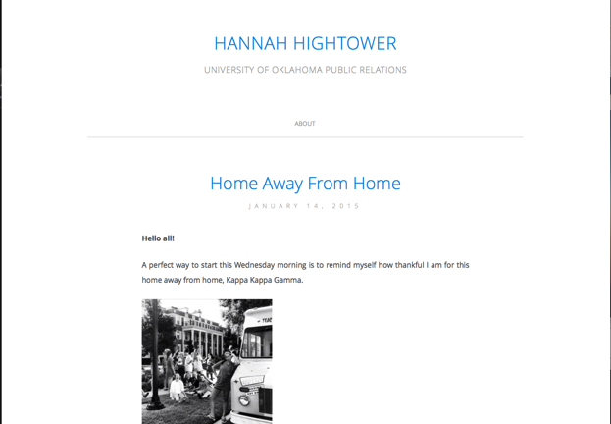
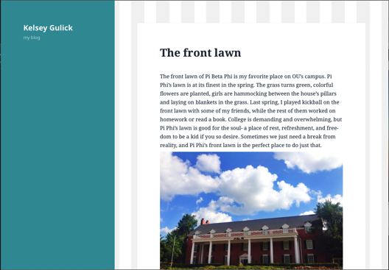
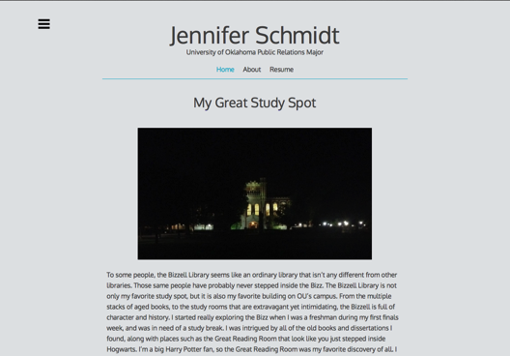

Slide 13
Towards self-actualization

Slide 14
“The creative process is specifically related to the process of self-actualization.”
Ryder, Willet W. "The role of art in self-actualization." Art Education 40.2 (1987): 22-24.

Slide 15
Four stages of self-actualization: 1. Awareness 2. Focus (selection/reflection) 3. The Working Process 4. The Product

Slide 16


Slide 17
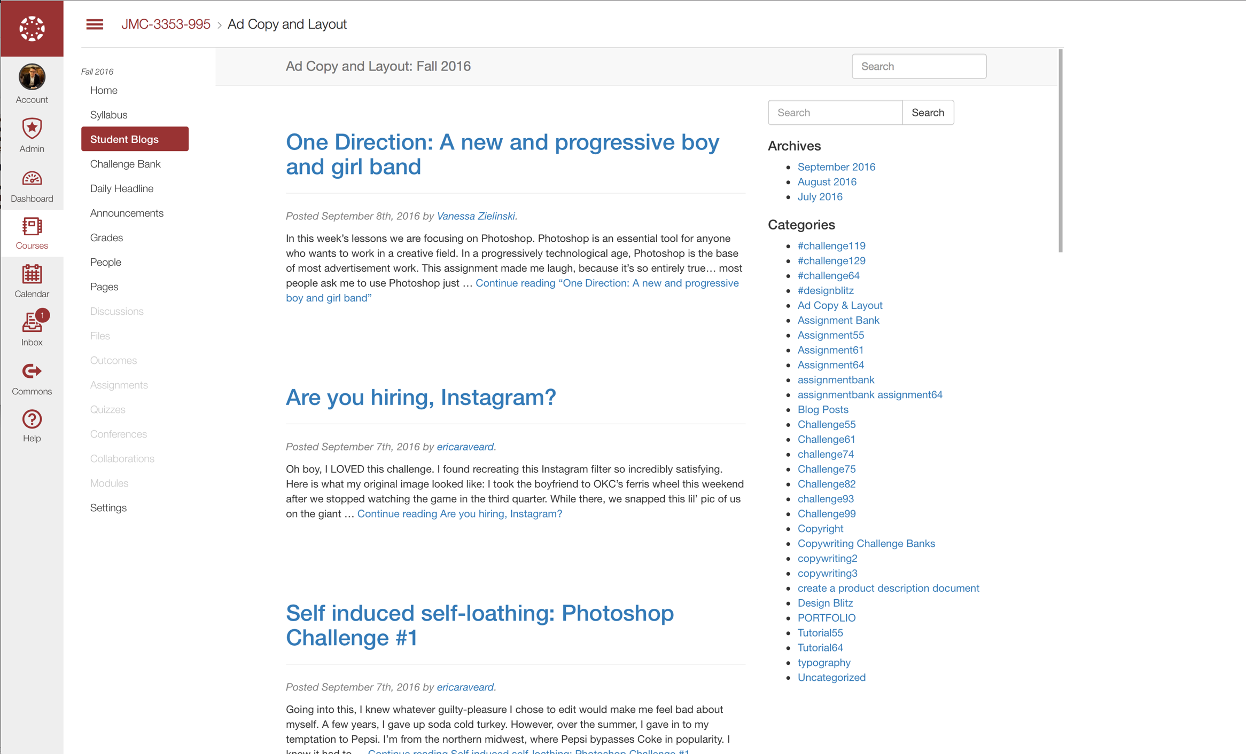

Slide 18
Four stages of self-actualization: 1. Awareness 2. Focus (selection/reflection) 3. The Working Process 4. The Product

Slide 19
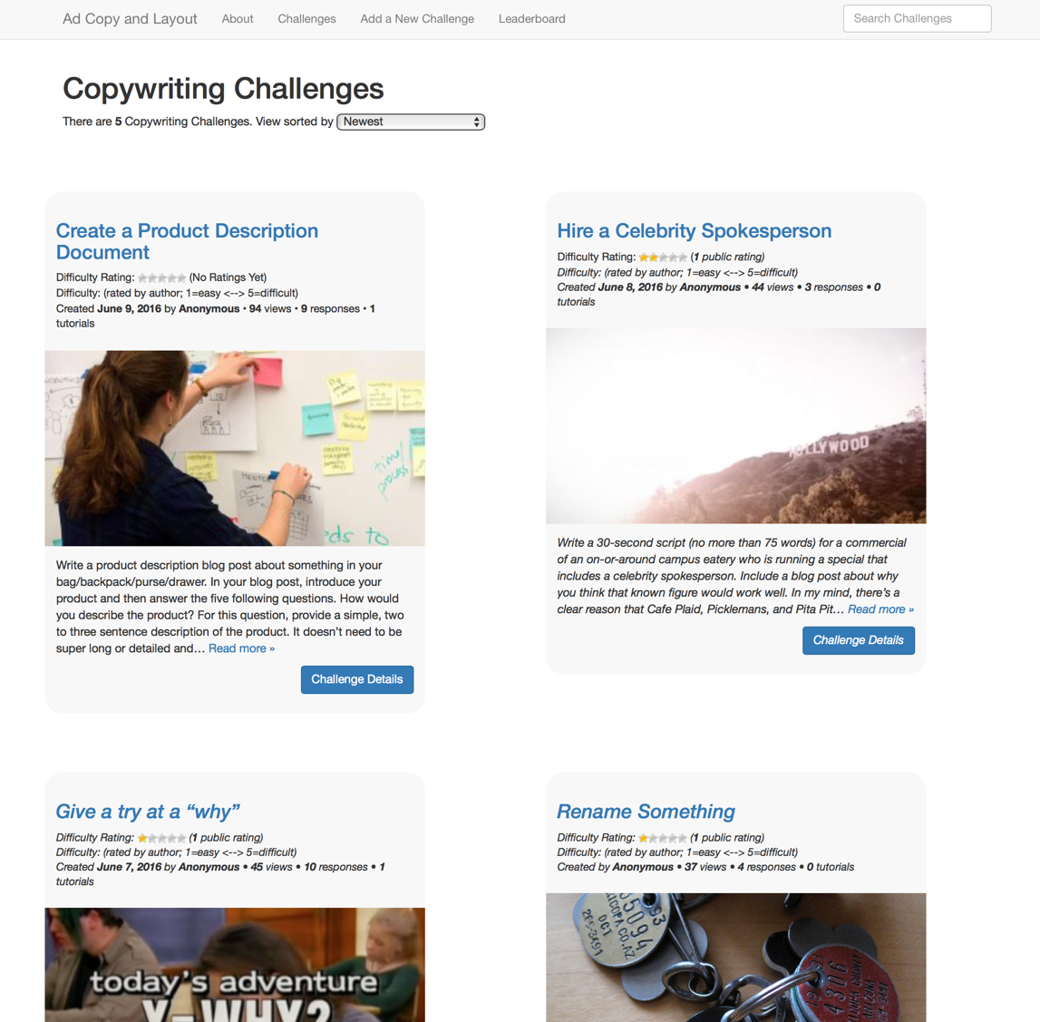

Slide 20
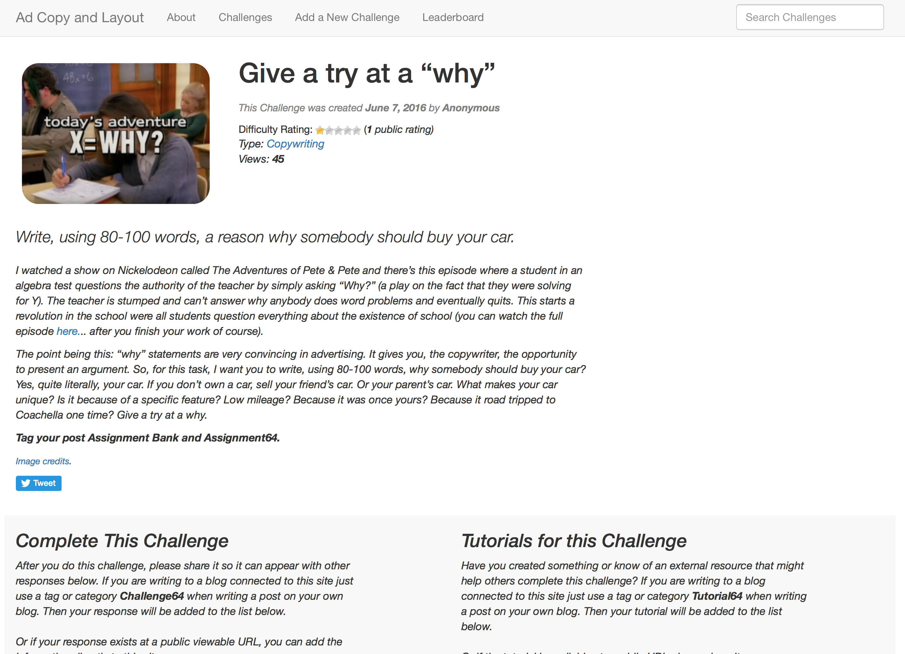

Slide 21
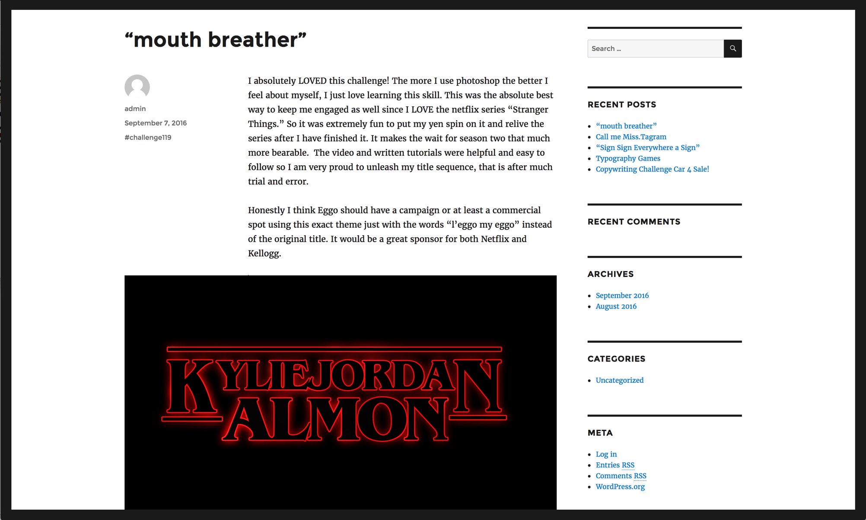

Slide 22
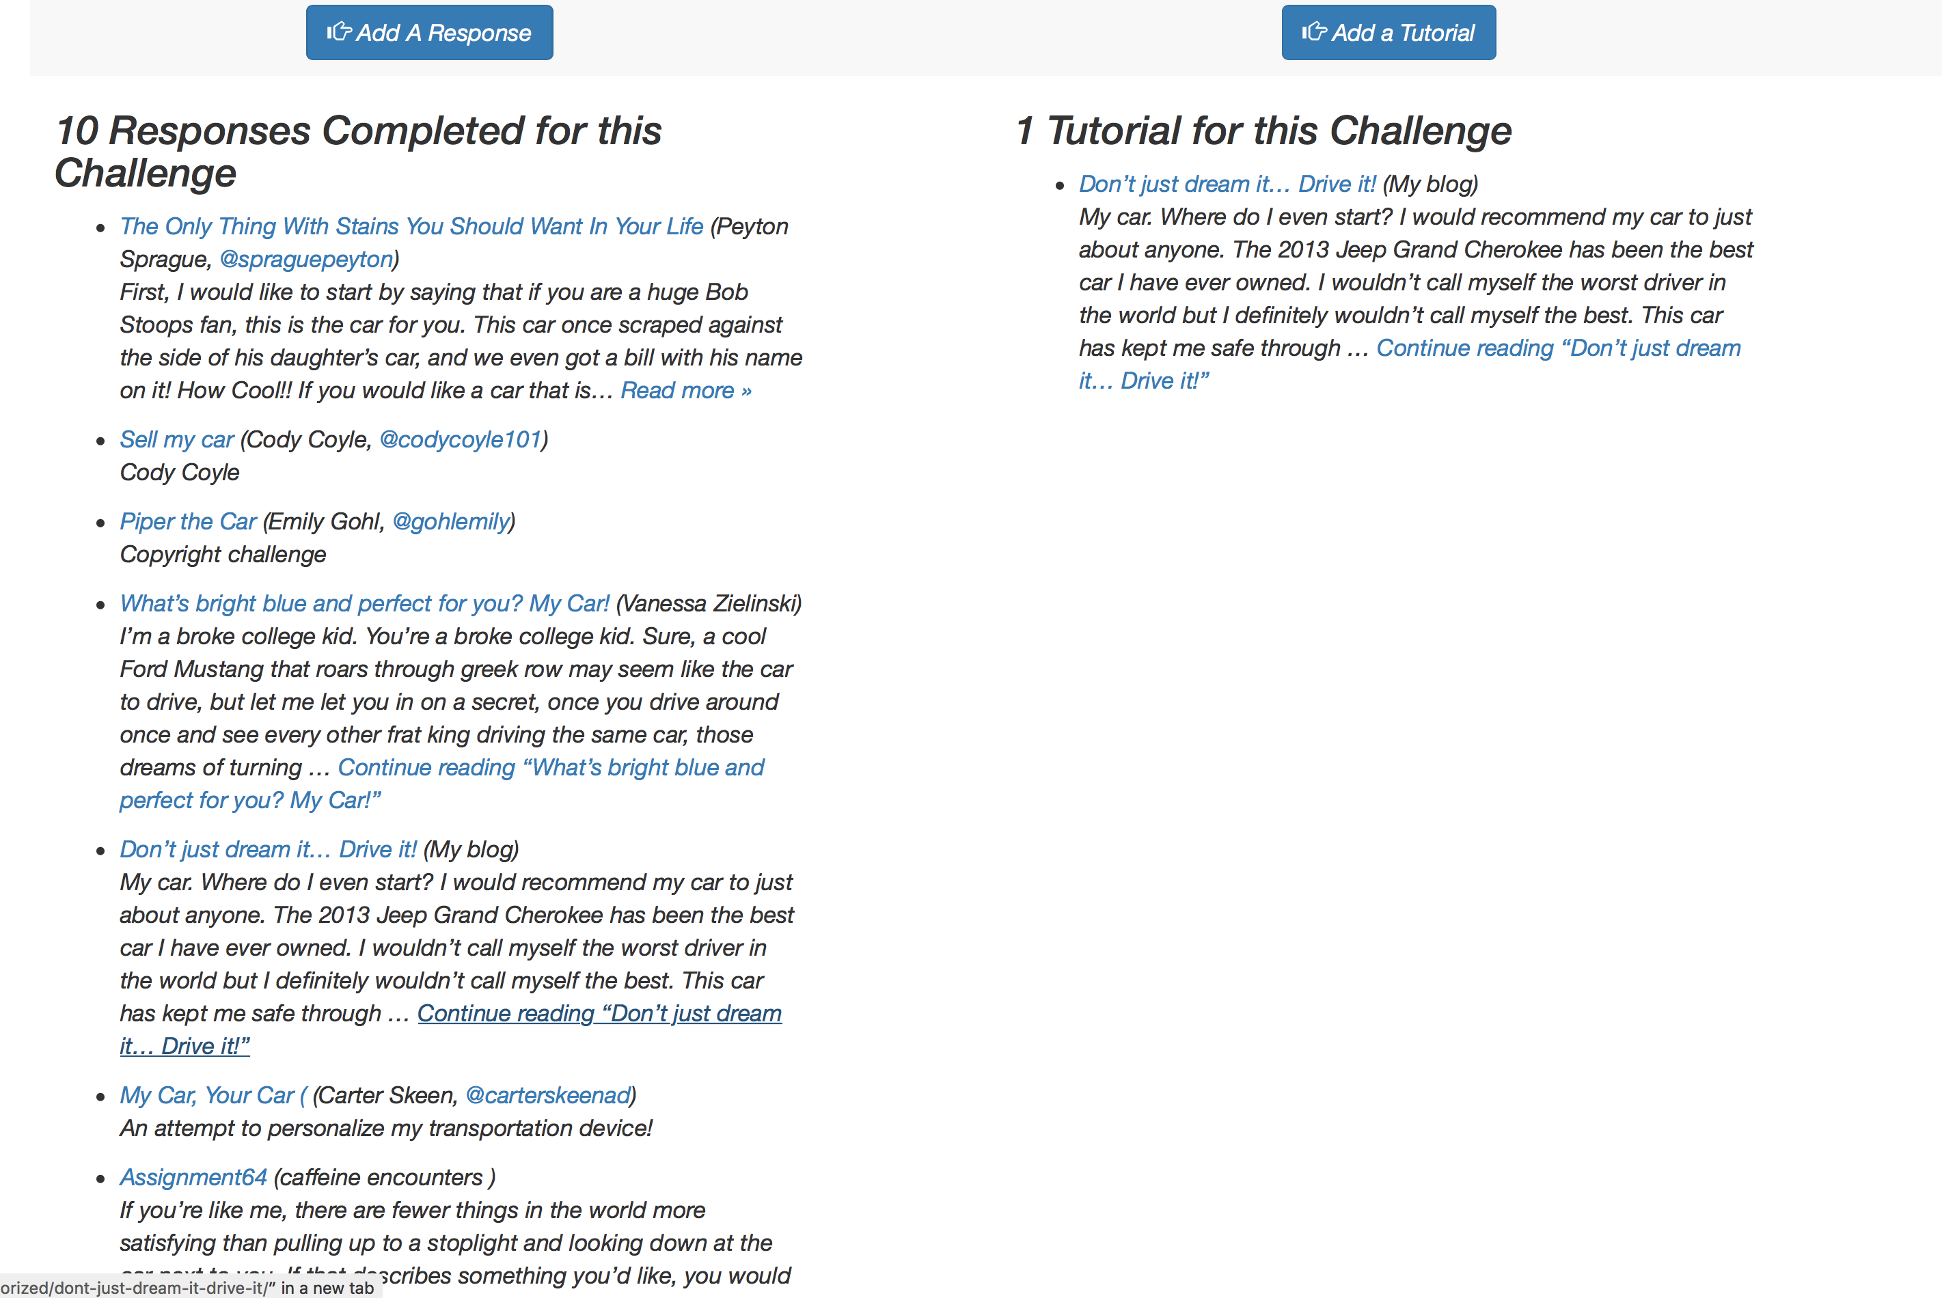

Slide 23
Four stages of self-actualization: 1. Awareness 2. Focus (selection/reflection) 3. The Working Process 4. The Product

Slide 24
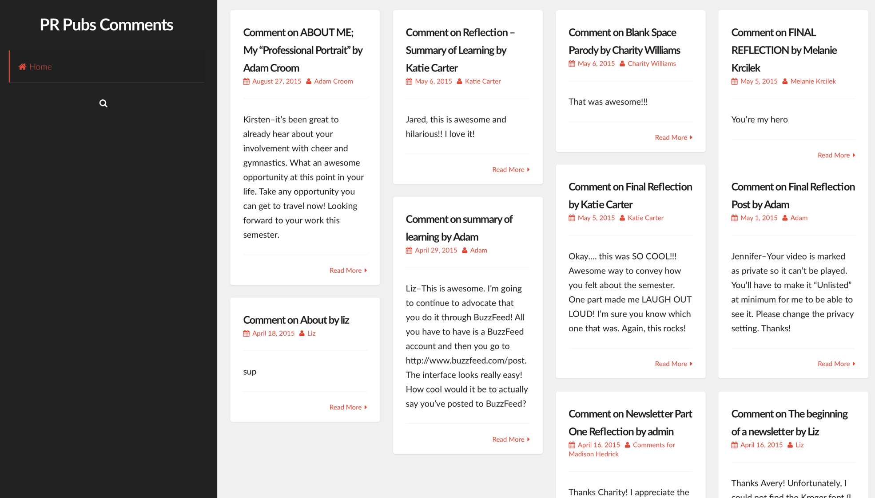

Slide 25
Four stages of self-actualization: 1. Awareness 2. Focus (selection/reflection) 3. The Working Process 4. The Product

Slide 26
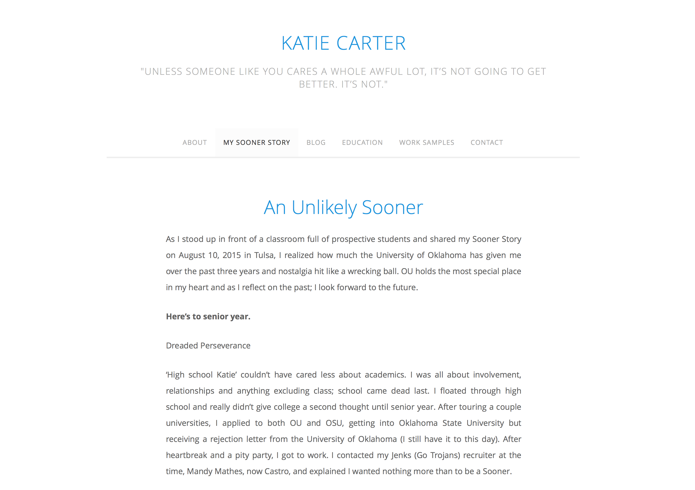

Slide 27


Slide 28
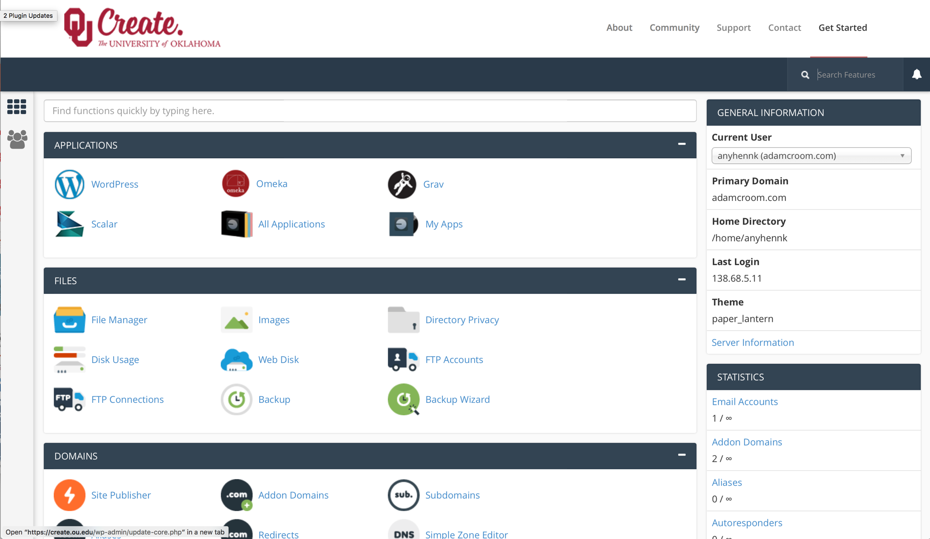

Slide 29


Slide 30


Slide 31
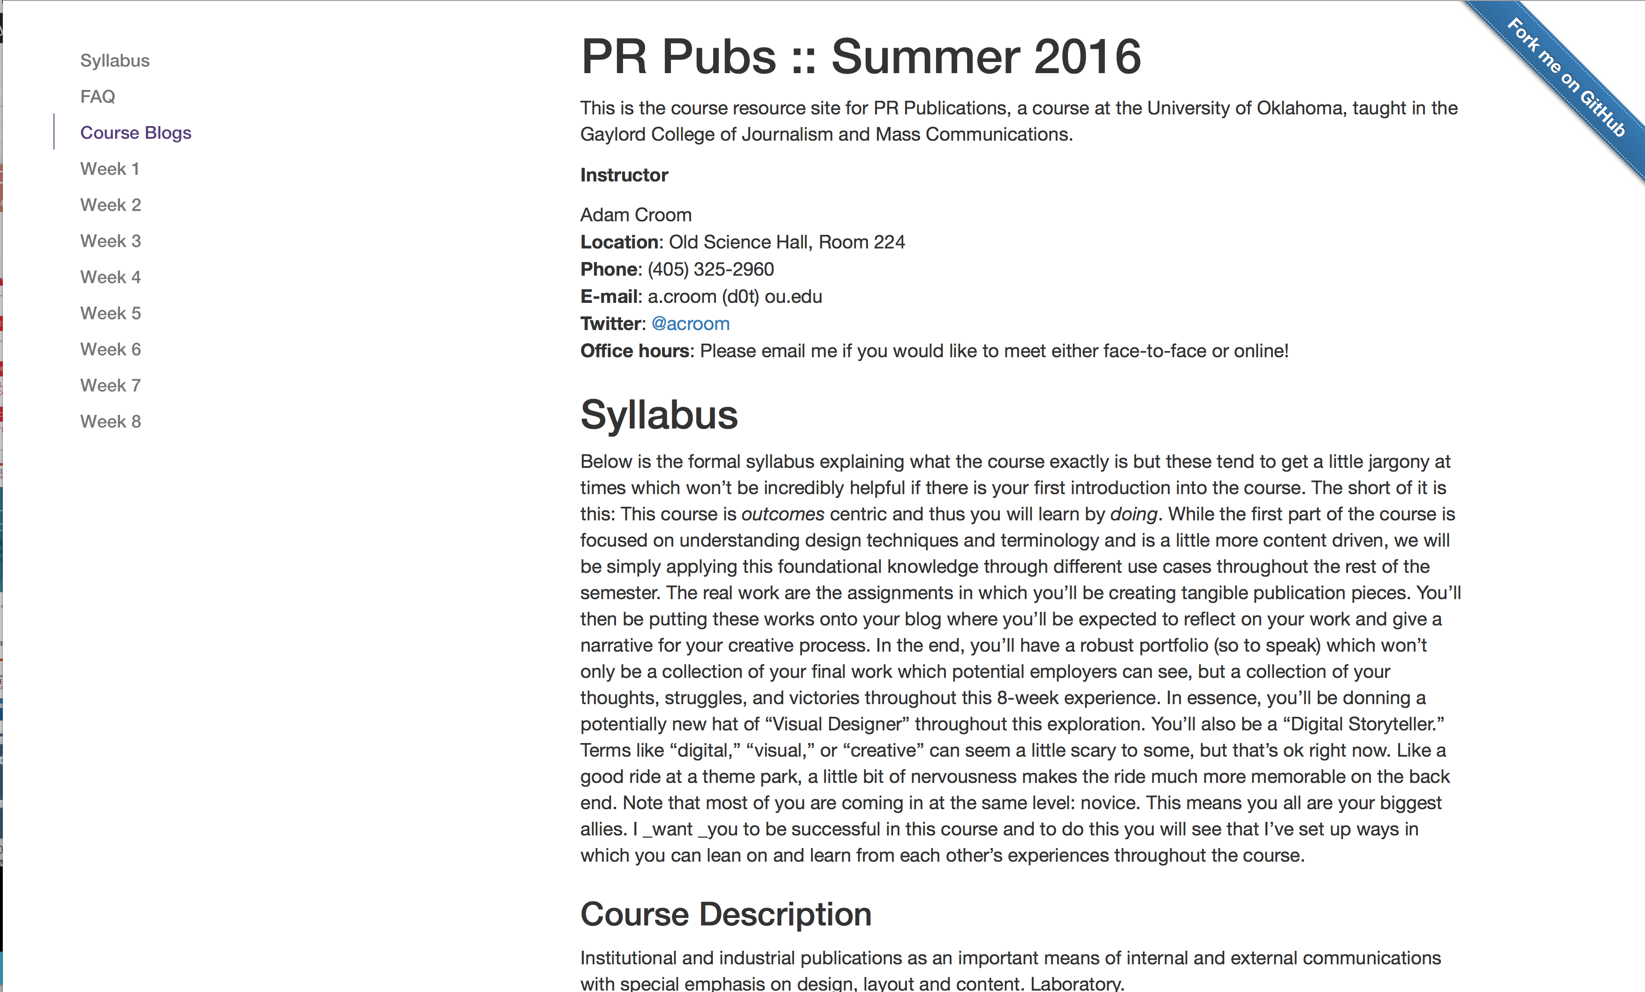

Slide 32
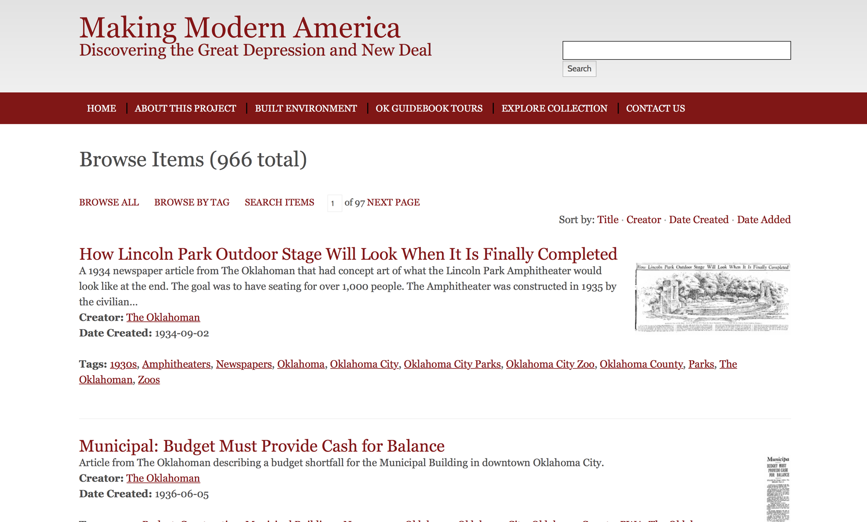

Slide 33
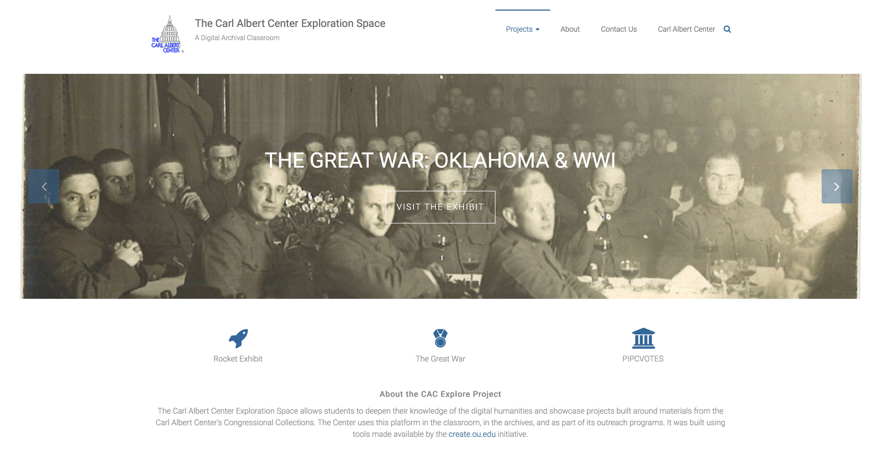

Slide 34
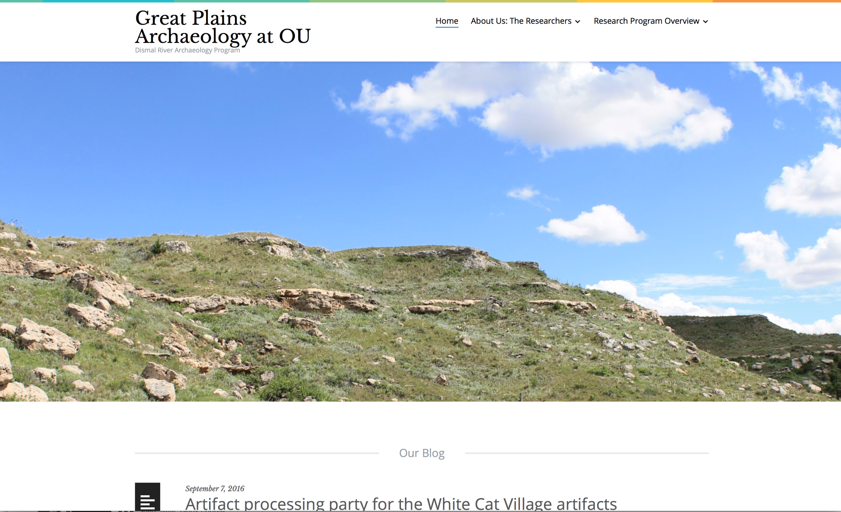

Slide 35
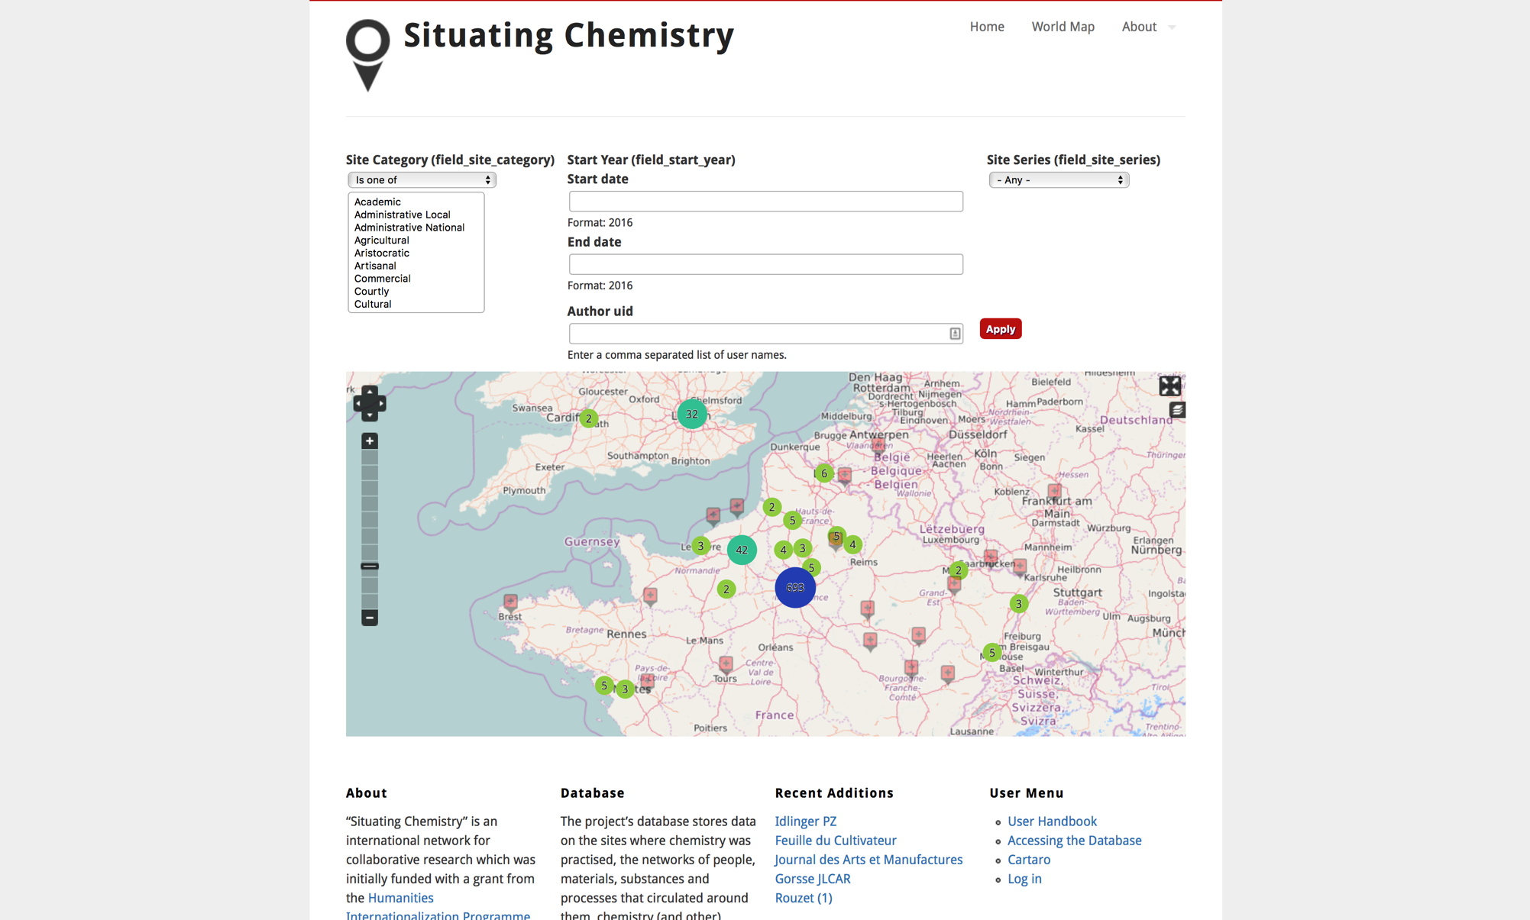

Slide 36


Slide 37
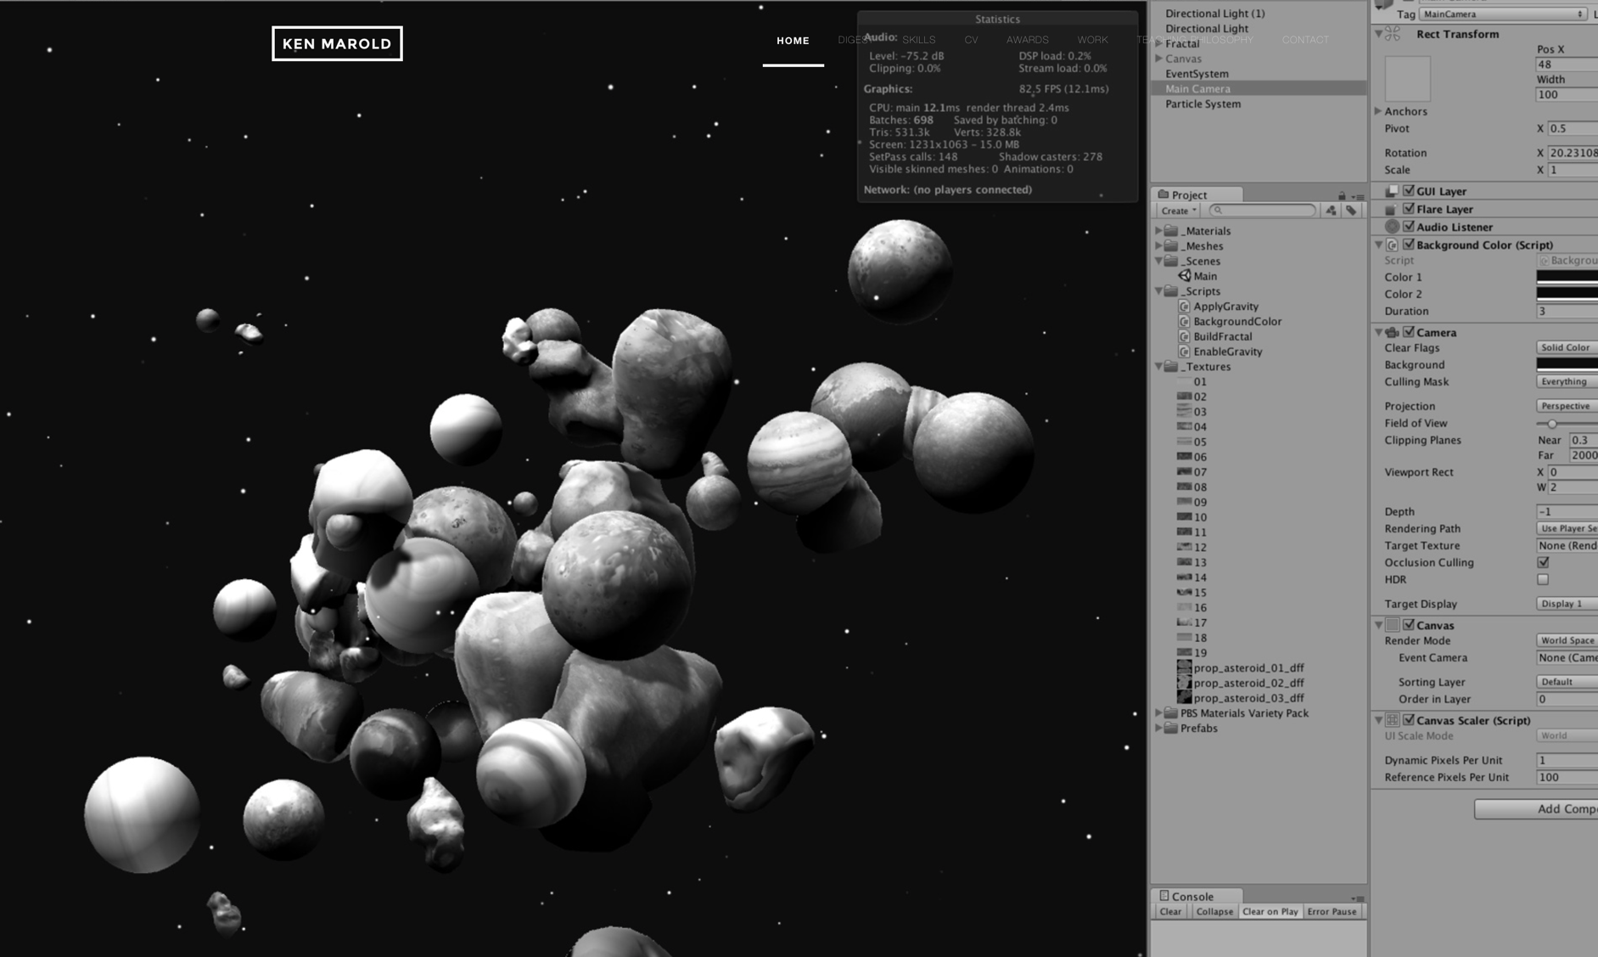

Slide 38
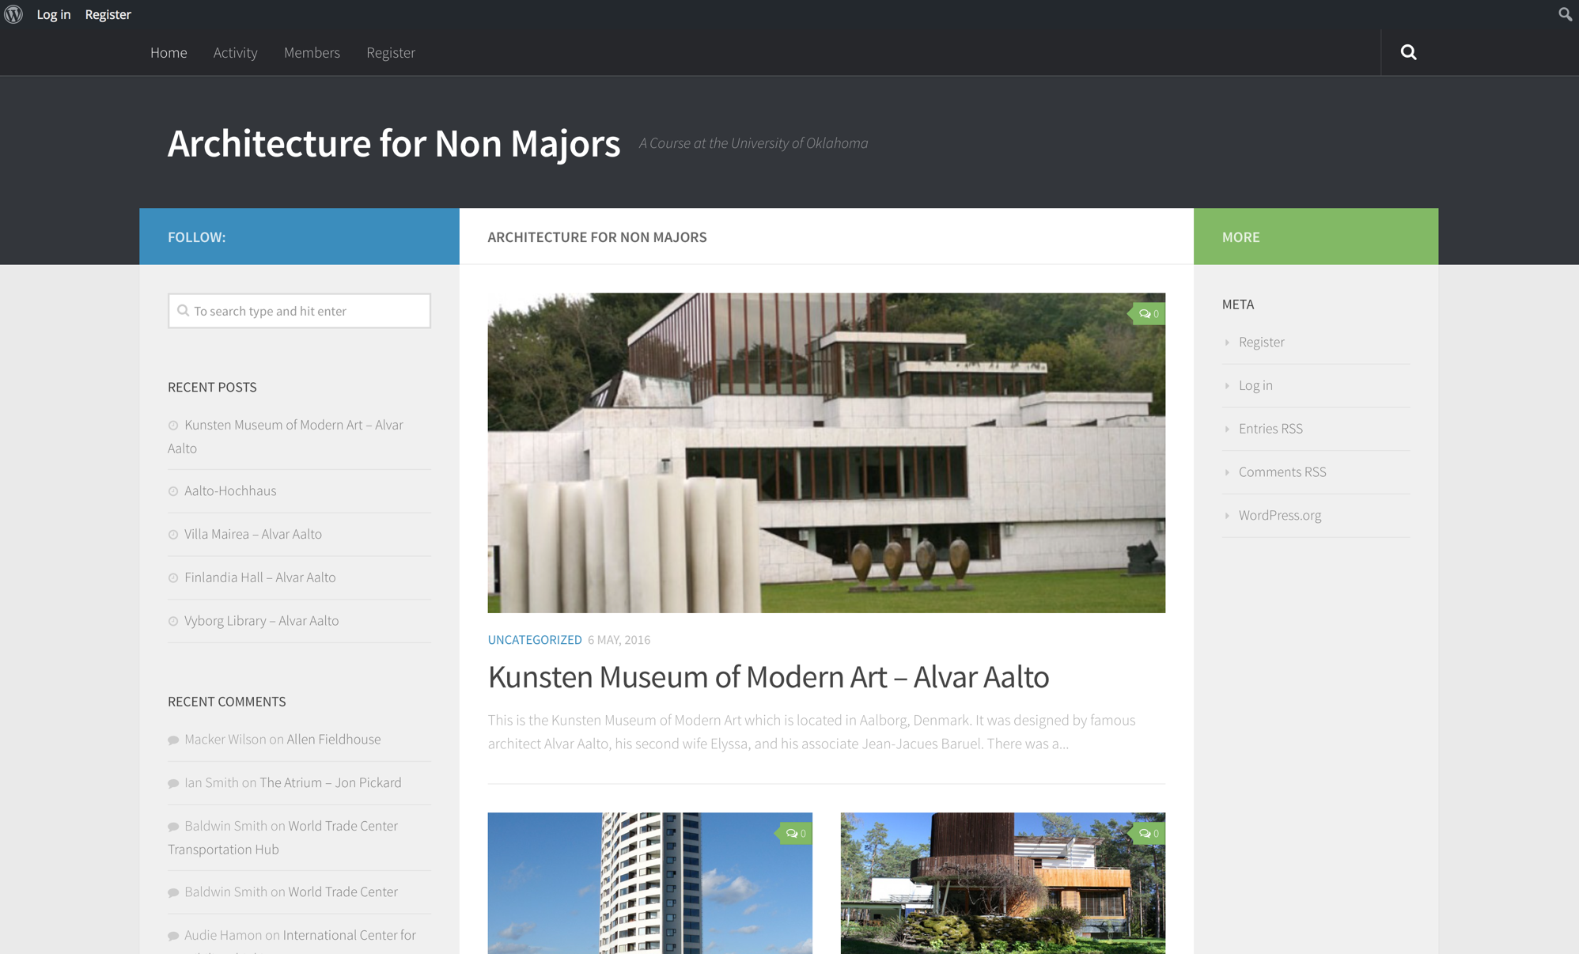

Slide 39
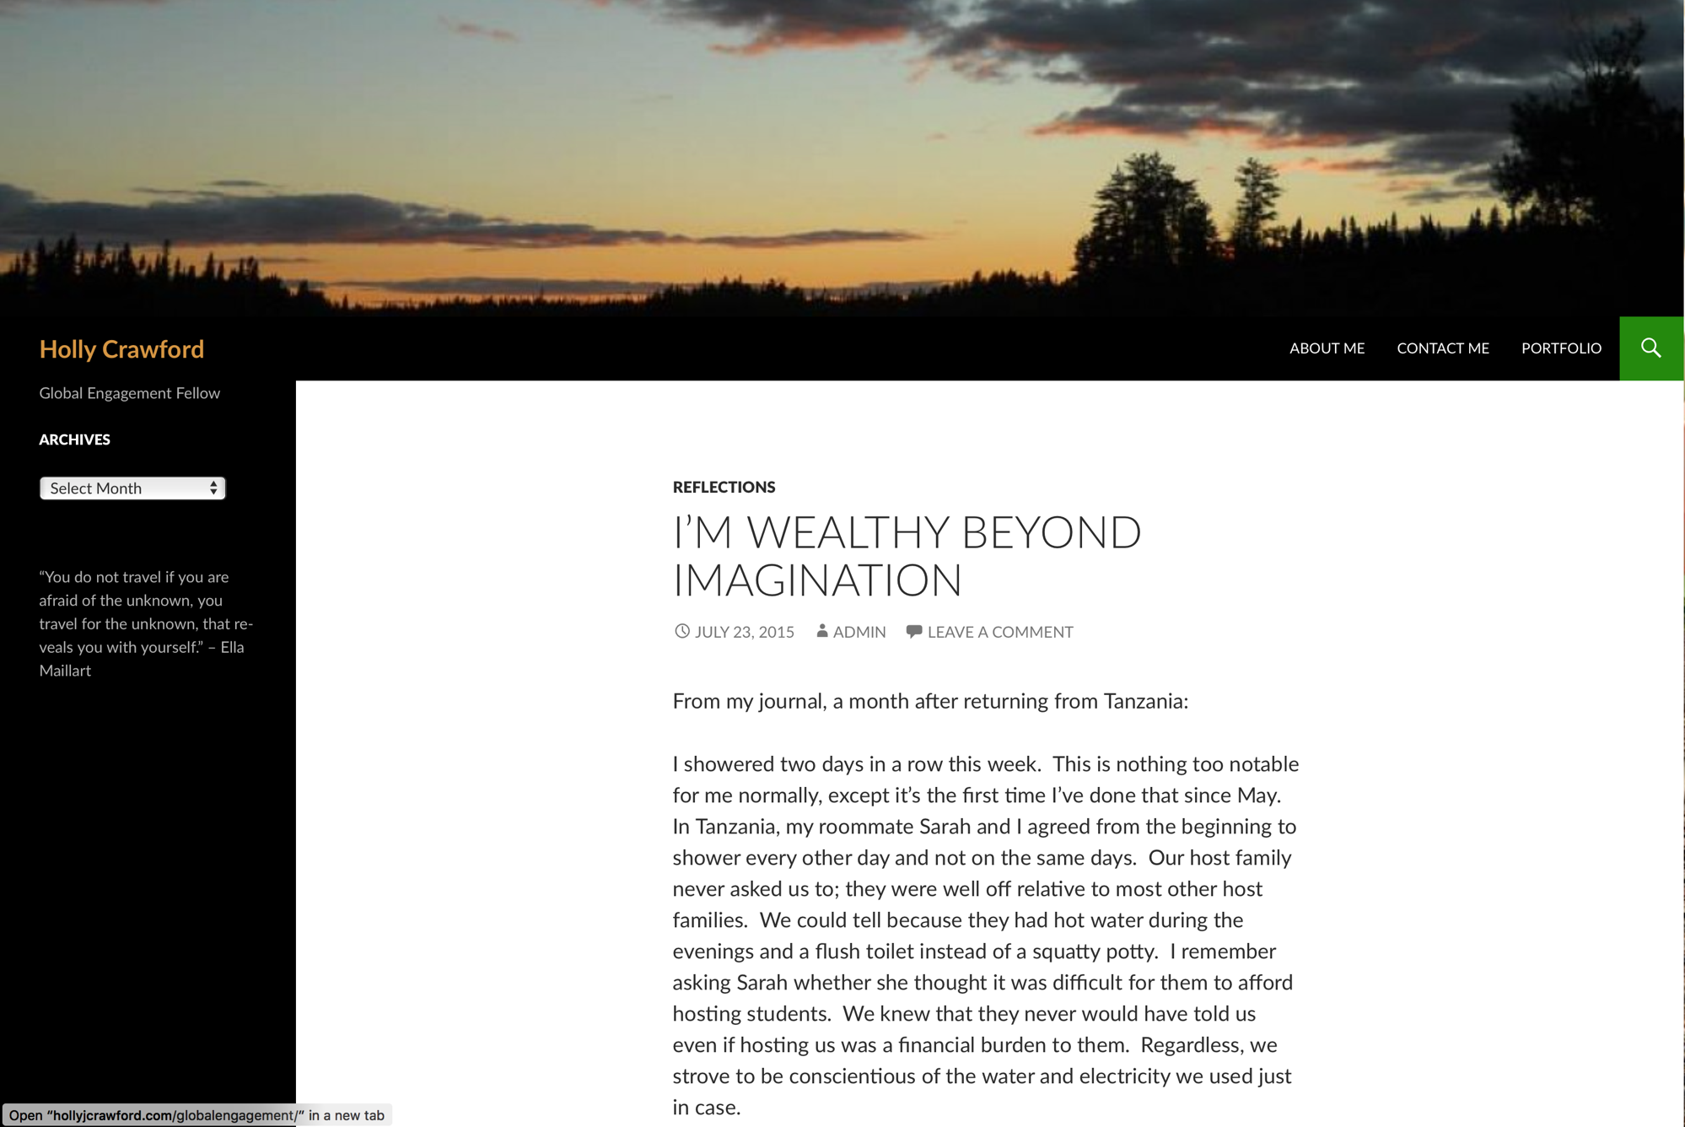

Slide 40
